Slide 1


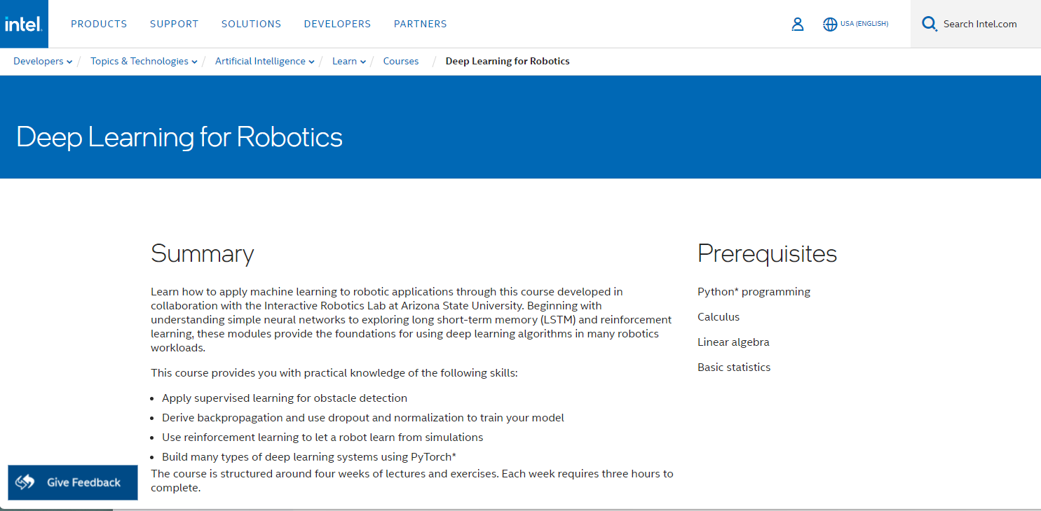
CSC485B Machine Learning for Robotics
SUNY Plattsburgh
Dr. Ned Lecky
Class 15- Running Exercise 1 IDLR

Slide 2
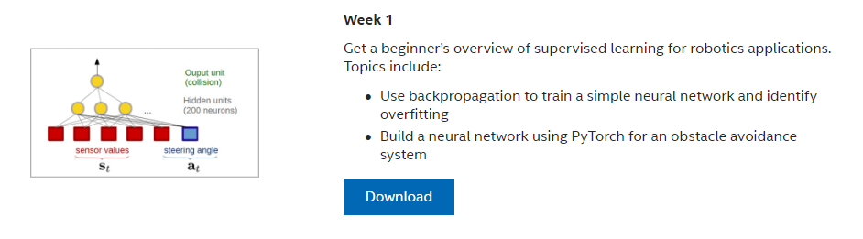
IDLR Week 1

Slide 3
Getting the Code to Run
Always a Process…

Slide 4
Follow the Author’s Readme.MD Just do it…
conda create -n intel_game_env # Python 3.7.16
conda activate intel_game_env
conda install pytorch-cpu -c pytorch # 1.1.0
pip install cython # 0.29.33
pip install torchvision # 0.14.1… Moves us to torch 1.13.1
pip install pygame # 2.3.0
pip install pymunk # 6.4.0

Slide 5
And it doesn’t run
(intel_game_env) > python PlayingTheModel.py
pygame 2.3.0 (SDL 2.24.2, Python 3.7.16)
Hello from the pygame community. https://www.pygame.org/contribute.html
Traceback (most recent call last):
File "PlayingTheModel.py", line 288, in <module>
env = BotEnv()
File "PlayingTheModel.py", line 55, in __init__
self.BuildBot(100, 300, 20)
File "PlayingTheModel.py", line 92, in BuildBot
BoxPoints = list(map(Vec2d, [(-size, -size), (-size, size), (size,size), (size, -size)]))
TypeError: __new__() missing 1 required positional argument: 'y'

Slide 6
What is going wrong?
Looks like the new version of pymunk has different calling conventions
https://stackoverflow.com/questions/67549640/type-error-new-missing-1-required-positional-argument-y
So what can you do?
You probably should let the people at Intel know that their code is broken with Pymunk 6.0.0 and higher. For the time being you could try to use a version of Pymunk prior to 6.0.0 (that is probably the best solution) or you could change the code that comes with the course and use one of the options above.

Slide 7
Fix?
pip install pymunk==5.7.0
And now it works…
python PlayingTheModel.py
So let’s try the whole chain
Python ExploreAndCollect.py
Python MakeItLearn.py
Loss 479.946, 0.1643, 0.1643, 0.1643, 0.1643, … ???
Python PlayingTheModel.py
Bot just goes in circles!

Slide 8
Try 1: Maybe try earlier versions
Versions of torchvision (which includes torch) LINK
conda deactivate
conda remove intel_game_env –-all
conda create -n intel_game_env python=3.6 # Python 3.6.13
conda activate intel_game_env
pip install cython # 0.29.33
pip install torchvision==0.9.0 # Installs torch 1.13.1
pip install pygame # 2.3.0
pip install pymunk==5.7.0 # 5.7.0
Now it runs, but…
Still runs in circles

Slide 9
Try 2: Why not Conda install?
conda create -n nn1 python=3.6 # Python 3.6.13
conda activate nn1
conda install cython # 0.29.24
conda install torchvision # Won’t work– needs latest Python install pygame # 2.3.0
pip install pymunk==5.7.0 # 5.7.0
Failed to install

Slide 10
Try 3: Why not try latest EXCEPT pymunk?
conda create -n nn2 # Python 3.10.10
conda activate nn2
conda install torchvision # Torch 1.12.1 Torchvision 0.13.1
pip install pygame # 2.3.0 Won’t install through Conda
pip install pymunk==5.7.0 # 5.7.0 Won’t install through Conda
Code runs but still runs in circles
Maybe the code is fine and our hyperparameters aren’t!
Can get it to work as long as lr<0.001!!

Slide 11
Code Walkthrough
How did they do this and where did they cheat?

Slide 12
Three Main Modules
ExploreAndCollect.py
Use the game and physics models to just drive around and record sensors, steering angle, and whether we smacked into something
Random steering
MakeItLearn.py
Define the NN and hyperparameters (critical, of course)
PreProcessing.py
Slide the collision column up by 20 so we are predictive
Build test and train splits
PlayingTheModel.py
Use the game/physics models to drive around
An awful lot of heuristic driving built in… using the NN only to predict whether a crash will happen

Slide 13
What Are We Learning?
Python is a Sea of Versions
Hyperparameters are mysterious and trial-and-error
N-layers, n-neurons
Learning rate
There is a great deal of non-ML algorithm and heuristic involved in
Where to head
How to turn if collision is imminent
How to get out of a box
python PlayingTheModel.py 1
python PlayingTheModel.py 2
python PlayingTheModel.py 3
python PlayingTheModel.py 4 !!!!!!!

Slide 14
Summary
Most of the code is in the simulation!
Frequently the case
We have built a driving heuristic and are only using the NN to predict collision based on sensor data and proposed steering angle
HELLO!
Could you do this (better) without ML?
Often the case…
Often, though, you don’t get the idea for the heuristic until after the NN is working
What would you do?
Leave the NN in and ignore it (and say you’re using ML)
Rip out the NN

